Slide 1
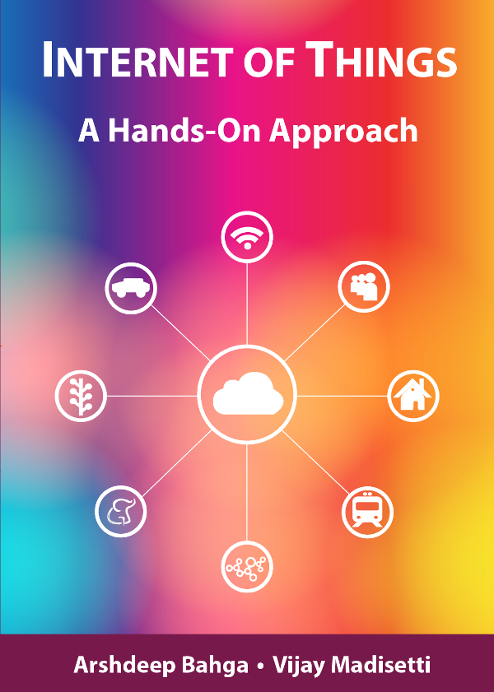
Unit 2
Chapter 1
Introduction to IoT
Book website: http://www.internet-of-things-book.com
Bahga & Madisetti, © 2015

Slide 2
Outline
Definition of IoT
Characteristics of IoT
Physical design of IoT
Logical design of IoT
IoT protocols
IoT levels and deployment templates
Book website: http://www.internet-of-things-book.com
Bahga & Madisetti, © 2015

Slide 3
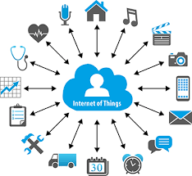
IoT

Slide 4
IoT
Internet Of Things is Fully Networked and Connected Devices sending analytics data back to cloud or data center.
The definition of Internet of things is that it is the network in which every object or thing is provided unique identifier and data is transferred through a network without any verbal communication.
Scope of IoT is not just limited to just connecting things to the internet, but it allows these things to communicate and exchange data, process them as well as control them while executing applications.

Slide 5
Formal Definition of IoT
A dynamic global network infrastructure with self- configuring capabilities based on standard and interoperable communication protocols, where physical and virtual “things” have identities, physical attributes, and use intelligent interfaces, and are seamlessly integrated into information network that communicate data with users and environments.

Slide 6
Characteristics of IoT
Dynamic & Self-Adapting : Adapt the changes w.r.t changing contexts and take actions based on their operating conditions, users context or sensed environment.
Self Configuring : Devices must be able to have self-configuring, allowing a large number of devices to work together.
Eg. Fetching latest s/w updates without manual intervention.
Interoperable Communication Protocols : IoT devices may support a number of interoperable communication protocols and can communicate with other devices and infrastructure.
Unique Identity : Such as Unique IP Address or a URI, that allows the user to query the devices, monitor their status and control them.
Integrated into Information Network : This allows to communicate and exchange data with other devices and system to perform certain analysis.

Slide 7
Physical Design of IoT
Things in IoT
IoT Protocols

Slide 8
Things in IoT
Refers to IoT devices which have unique identities that can perform sensing, actuating and monitoring capabilities.
IoT devices can exchange data with other connected devices or collect data from other devices and process the data either locally or send the data to centralized servers or cloud – based application back-ends for processing the data.

Slide 9
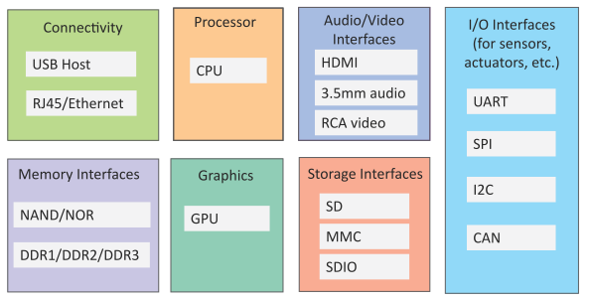
Generic Block Diagram of an IoT Device
An IoT device may consist of several interfaces for connections to other devices, both wired and wireless.
I/O interfaces for sensors
Interfaces for internet connectivity
Memory and storage interfaces
Audio/video interfaces
Book website: http://www.internet-of-things-book.com
Bahga & Madisetti, © 2015

Slide 10
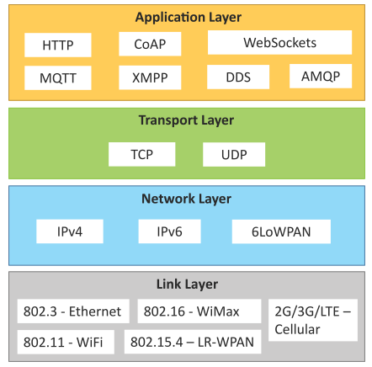
IoT Protocols
Link Layer
802.3 – Ethernet
802.11 – WiFi
802.16 – WiMax
802.15.4 – LR-WPAN
2G/3G/4G
Network/Internet Layer
IPv4
IPv6
6LoWPAN
Transport Layer
TCP
UDP
Application Layer
HTTP
CoAP
WebSocket
MQTT
XMPP
DDS
AMQP
Book website: http://www.internet-of-things-book.com
Bahga & Madisetti, © 2015

Slide 11
IoT Protocols…Link Layer…Ethernet 802.3
Sr.No | Standard | Shared medium
1 | 802.3 | Coaxial Cable…10BASE5
2 | 802.3.i | Copper Twisted pair …..10BASE-T
3 | 802.3.j | Fiber Optic……10BASE-F
4 | 802.3.ae | Fiber…..10Gbits/s
Data Rates are provided from 10Gbit/s to 40Gb/s and higher

Slide 12
IoT Protocols…Link Layer…WiFi 802.11
Sr.No | Standard | Operates in
1 | 802.11a | 5 GHz band
2 | 802.11b and 802.11g | 2.4GHz band
3 | 802.11.n | 2.4/5 GHz bands
4 | 802.11.ac | 5GHz band
5 | 802.11.ad | 60Hz band
Collection of Wireless LAN
Data Rates from 1Mb/s to 6.75 Gb/s

Slide 13
IoT Protocols…Link Layer…WiMax 802.16
Sr.No | Standard | Data Rate
1 | 802.16m | 100Mb/s for mobile stations 1Gb/s for fixed stations
Collection of Wireless Broadband standards
Data Rates from 1.5Mb/s to 1 Gb/s

Slide 14
IoT Protocols…Link Layer…LR-WPAN 802.15.4
Collection of standards for low-rate wireless personal area networks
Basis for high level communication protocols such as Zigbee
Data Rates from 40Kb/s to 250Kb/s
Provide low-cost and low-speed communication for power constrained devices

Slide 15
IoT Protocols…Link Layer…2G/3G/4G –Mobile Communication
Sr.No | Standard | Operates in
1 | 2G | GSM-CDMA
2 | 3G | UMTS and CDMA 2000
3 | 4G | LTE
Data Rates from 9.6Kb/s (for 2G) to up to 100Mb/s (for 4G)

Slide 16
IoT Protocols…Network/Internet Layer
Responsible for sending of IP datagrams from source to destination network
Performs the host addressing and packet routing
Host identification is done using hierarchical IP addressing schemes such as IPV4 or IPV6

Slide 17
IoT Protocols…Network Layer
IPV4
Used to identify the devices on a network using hierarchical addressing scheme
Uses 32-bit address scheme
IPV6
Uses 128-bit address scheme
6LoWPAN (IPV6 over Low power Wireless Personal Area Network)
Used for devices with limited processing capacity
Operates in 2.4 Ghz
Data Rates of 250Kb/s

Slide 18
IoT Protocols…Transport Layer
Provide end-to-end message transfer capability independent of the underlying network
It provides functions such as error control, segmentation, flow-control and congestion control

Slide 19
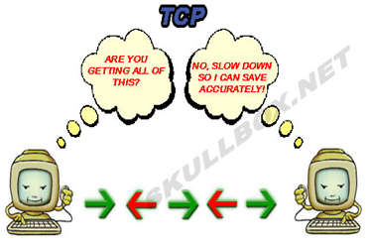
IoT Protocols…Transport Layer…TCP
Transmission Control Protocol (TCP)
Connection Oriented
Ensures Reliable transmission
Provides Error Detection Capability to ensure no duplicacy of packets and retransmit lost packets
Flow Control capability to ensure the sending data rate is not too high for the receiver process
Congestion control capability helps in avoiding congestion which leads to degradation of n/w performance

Slide 20
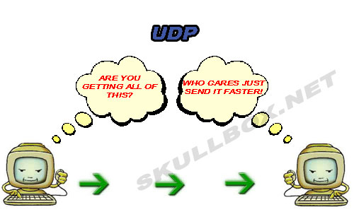
IoT Protocols…Transport Layer…UDP
User Datagram Protocol
Connectionless
Does not ensures Reliable transmission
Does not do connection before transmitting
Does not provide proper ordering of messages
Transaction oriented and stateless

Slide 21
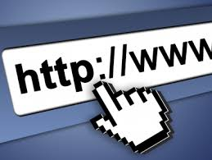
IoT Protocols…Application Layer…Hyper Transfer Protocol
Forms foundation of World Wide Web(WWW)
Includes commands such as GET,PUT, POST, HEAD, OPTIONS, TRACE..etc
Follows a request-response model
Uses Universal Resource Identifiers(URIs) to identify HTTP resources

Slide 22
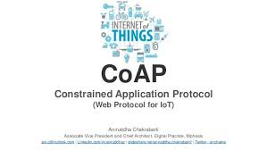
IoT Protocols…Application Layer…CoAP
Constrained Application Protocol
Used for Machine to machine (M2M) applications meant for constrained devices and n/w’s
Web transfer protocol for IoT and uses request-response model
Uses client –server architecture
Supports methods such as GET,POST, PUT and DELETE

Slide 23
IoT Protocols…Application Layer…WebSocket
Allows full-duplex communication over single socket
Based on TCP
Client can be a browser, IoT device or mobile application
IoT Protocols…Application Layer…MQTT
Message Queue Telemetry Transport , light-weight messaging protocol
Based on publish-subscribe model
Well suited for constrained environments where devices have limited processing, low memory and n/w bandwith requirement

Slide 24
IoT Protocols…Application Layer…XMPP
Extensible messaging and presence protocol
For Real time communication and streaming XML data between n/w entities
Used for Applications such as Multi-party chat and voice/video calls.
Decentralized protocol and uses client server architecture.

Slide 25
IoT Protocols…Application Layer…DDS
Data Distribution service is a data-centric middleware standard for device-to-device or machine-to-machine communication.
Publish subscribe model where publishers create topics to which subscribers can use.
Provides Quality-of-service control and configurable reliability.

Slide 26
IoT Protocols…Application Layer…AMQP
Advanced Messaging Queuing Protocol used for business messaging.
Supports both point-to-point and publisher/subscriber models, routing and queuing
Broker here receives messages from publishers and route them over connections to consumers through messaging queues.

Slide 27
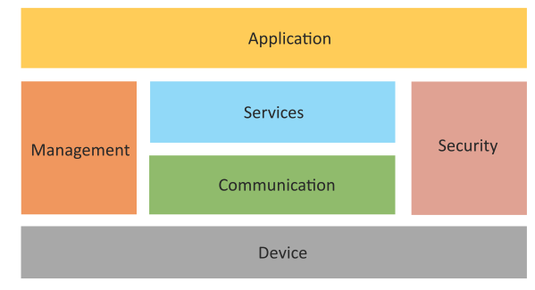
Logical Design of IoT
Logical design of an IoT system refers to an abstract representation of the entities and processes without going into the low-level specifics of the implementation.
An IoT system comprises a number of functional blocks that provide the system the capabilities for identification, sensing, actuation, communication and management.
Book website: http://www.internet-of-things-book.com
Bahga & Madisetti, © 2015

Slide 28
Logical Design of IoT
Device : Devices such as sensing, actuation, monitoring and control functions.
Communication : IoT Protocols
Services like device monitoring, device control services, data publishing services and device discovery
Management : Functions to govern the system
Security : Functions as authentication, authorization, message and content integrity, and data security
Applications
Book website: http://www.internet-of-things-book.com
Bahga & Madisetti, © 2015

Slide 29
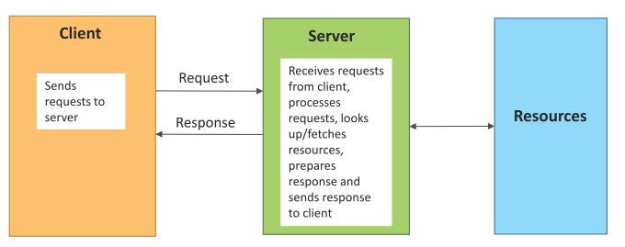
Request–Response Communication Model
Request–Response is a communication model in which the client sends requests to the server and the server responds to the requests.
When the server receives a request, it decides how to respond, fetches the data, retrieves resource representations, prepares the response and then sends the response to the client.
Stateless communication model
Book website: http://www.internet-of-things-book.com
Bahga & Madisetti, © 2015

Slide 30
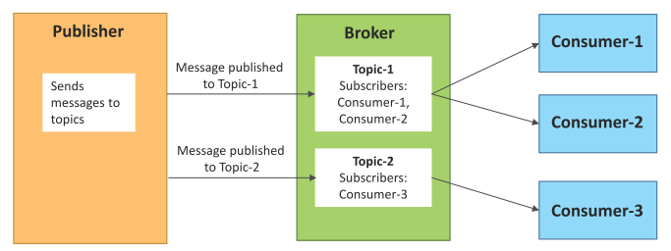
Publish–Subscribe Communication Model
Publish–Subscribe is a communication model that involves publishers, brokers and consumers.
Publishers are the source of data. Publishers send the data to the topics which are managed by the broker. Publishers are not aware of the consumers.
Consumers subscribe to the topics which are managed by the broker.
When the broker receives data for a topic from the publisher, it sends the data to all the subscribed consumers.
Book website: http://www.internet-of-things-book.com
Bahga & Madisetti, © 2015

Slide 31
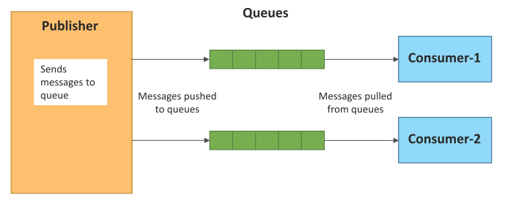
Push–Pull Communication Model
Push–Pull is a communication model in which the data producers push the data to queues and the consumers pull the data from the queues. Producers do not need to be aware of the consumers.
Queues help in decoupling the messaging between the producers and consumers.
Queues also act as a buffer which helps in situations when there is a mismatch between the rate at which the producers push data and the rate at which the consumers pull data.
Book website: http://www.internet-of-things-book.com
Bahga & Madisetti, © 2015

Slide 32
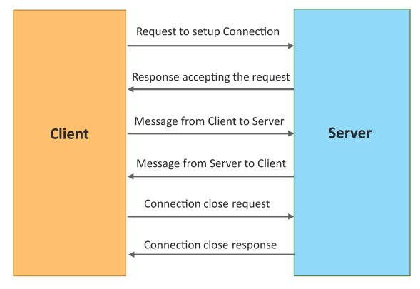
Exclusive Pair Communication Model
Exclusive Pair is a bidirectional, fully duplex communication model that uses a persistent connection between the client and the server.
Once the connection is set up it, remains open until the client sends a request to close the connection.
Client and server can send messages to each other after connection setup.
Book website: http://www.internet-of-things-book.com
Bahga & Madisetti, © 2015

Slide 33
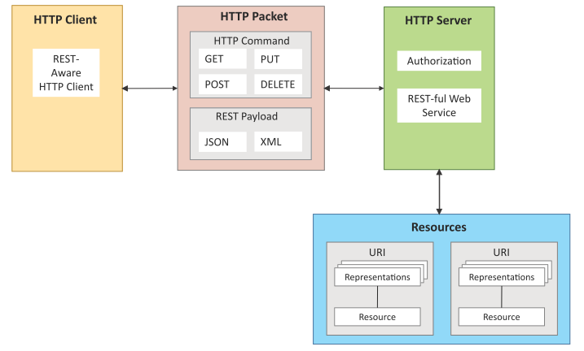
REST-based Communication APIs
Representational State Transfer (REST) is a set of architectural principles by which you can design web services and web APIs that focus on a system’s resources and how resource states are addressed and transferred.
REST APIs follow the request–response communication model.
REST architectural constraints apply to the components, connectors and data elements within a distributed hypermedia system.
Book website: http://www.internet-of-things-book.com
Bahga & Madisetti, © 2015

Slide 34
REST-based Communication APIs Constraints
Client – Server
Stateless
Cacheable
Layered System
Uniform Interface
Code on demand
Client
Server
Request
Response
Request
Response
Book website: http://www.internet-of-things-book.com
Bahga & Madisetti, © 2015

Slide 35
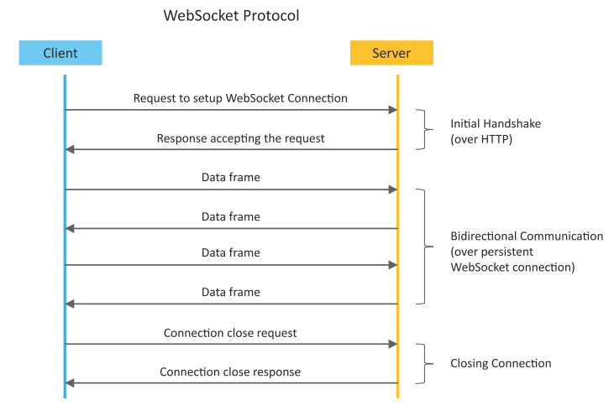
WebSocket-based Communication APIs
WebSocket APIs allow bi-directional, full duplex communication between clients and servers.
WebSocket APIs follow the exclusive pair communication model.
Book website: http://www.internet-of-things-book.com
Bahga & Madisetti, © 2015

Slide 36
Difference between REST and WebSocket-based Communication APIs
Comparison Based on | REST | Websocket
State | Stateless | Stateful
Directional | Unidirectional | Bidirectional
Req-Res/Full Duplex | Follow Request Response Model | Exclusive Pair Model
TCP Connections | Each HTTP request involves setting up a new TCP Connection | Involves a single TCP Connection for all requests
Header Overhead | Each request carries HTTP Headers, hence not suitable for real-time | Does not involve overhead of headers.
Scalability | Both horizontal and vertical are easier | Only Vertical is easier

Slide 37
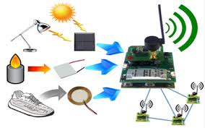
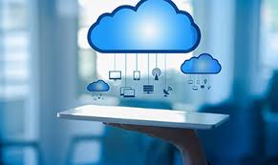
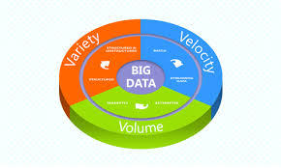
IoT Enabling Technologies
Wireless Sensor Network
Cloud Computing
Big Data Analytics
Embedded Systems

Slide 38
1) WSN
Distributed Devices with sensors used to monitor the environmental and physical conditions
Consists of several end-nodes acting as routers or coordinators too
Coordinators collects data from all nodes / acts as gateway that connects WSN to internet
Routers route the data packets from end nodes to coordinators.

Slide 39
1) WSN
Some examples of WSNs used in IoT systems are described as follows:
Weather monitoring system use WSNs in which the nodes collect temperature humidity and other data which is aggregated and analyzed.
Indoor air quality monitoring systems use WSNs to collect data on the indoor air quality and concentration of various gases
Soil moisture monitoring system use WSNs to monitor soil moisture at various locations.
Surveillance system use WSNs for collecting Surveillance data (such as motion detection data)
Smart grid use WSNs for monitoring the grid at various points.
Structural health monitoring system use WSNs to monitor the health of structures ( buildings, bridges) by collecting vibration data from sensor nodes de deployed at various points in the structure.
Protocols : Zigbee

Slide 40
2) Cloud Computing
Deliver applications and services over internet
Provides computing, networking and storage resources on demand
Cloud computing performs services such as Iaas, Paas and Saas
Iaas : Rent Infrastructure
Paas : supply an on-demand environment for developing, testing, delivering and managing software applications.
Saas : method for delivering software applications over the Internet, on demand and typically on a subscription basis.

Slide 41
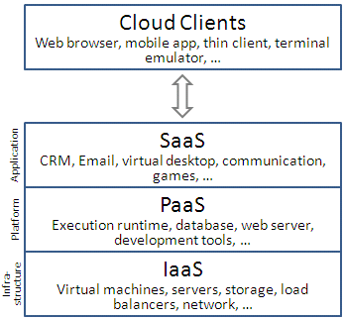
2) Cloud Computing

Slide 42

3) Big Data Analytics
Collection of data whose volume, velocity or variety is too large and difficult to store, manage, process and analyze the data using traditional databases.
It involves data cleansing, processing and visualization
Lots of data is being collected and warehoused
Web data, e-commerce
purchases at department/ grocery stores
Bank/Credit Card transactions
Social Network

Slide 43
3) Big Data Analytics.. Characteristics
Big data can be described by the following characteristics:
Volume
Variety
Velocity
Veracity

Slide 44
3) Big Data Analytics.. Characteristics
Big data can be described by the following characteristics:
Volume –
The quantity of generated and stored data.
The size of the data determines the value and potential insight, and whether it can be considered big data or not.
Volume refers to the amount of data
Terabyte
Records
Transactions
Files
Tables

Slide 45
3) Big Data Analytics.. Characteristics
Variety Includes different types of data
The type and nature of the data. This helps people who analyze it to effectively use the resulting insight.
Types:
Structured
Unstructured
SemiStructured
All of above

Slide 46
3) Big Data Analytics.. Characteristics
Velocity –
In this context, the speed at which the data is generated and processed to meet the demands and challenges that lie in the path of growth and development.
Big data is often available in real-time.
Compared to small data, big data are produced more continually.
Two kinds of velocity related to Big Data
frequency of generation and
frequency of handling, recording, and publishing.

Slide 47
3) Big Data Analytics.. Characteristics
Veracity –
It is the extended definition for big data, which refers to the data quality and the data value.
The data quality of captured data can vary greatly, affecting the accurate analysis.

Slide 48
3) Big Data Analytics
Some examples of big data generated by IoT systems are described as follows:
Sensor data generated by IoT system such as weather monitoring stations.
Machine sensor data collected from sensors embedded in industrial and energy systems for monitoring their health and detecting Failures.
Health and fitness data generated by IoT devices such as wearable fitness bands
Data generated by ioT systems for location and tracking of vehicles
Data generated by retail inventory monitoring systems

Slide 49
4) Communication protocols
Communication protocols form the backbone of IoT systems and enable network connectivity and coupling to applications.
Communication protocols allow devices to exchange data over the network.
Multiple protocols often describe different aspects of a single communication.
A group of protocols designed to work together are known as a protocol suite; when implemented in software they are a protocol stack.
Internet communication protocols are published by the Internet Engineering Task Force (IETF).
The IEEE handles wired and wireless networking, and the International Organization for Standardization (ISO) handles other types.
The ITU-T handles telecommunication protocols and formats for the public switched telephone network (PSTN).
In IoT we used MQTT, COAP, AMQP etc. protocols.

Slide 50
5) Embedded Systems
Embedded means something that is attached to another thing.
It can be thought of as a computer hardware system having software embedded in it.
It can be an independent system or it can be a part of a large system.
An embedded system is a controller programmed and controlled by a real-time operating system (RTOS) with a dedicated function within a larger mechanical or electrical system, often with real-time computing constraints.
Ninety-eight percent of all microprocessors are manufactured to serve as embedded system component.
An embedded system has three components −
It has hardware.
It has application software.
It has Real Time Operating system (RTOS) that supervises the application software and provide mechanism

Slide 51
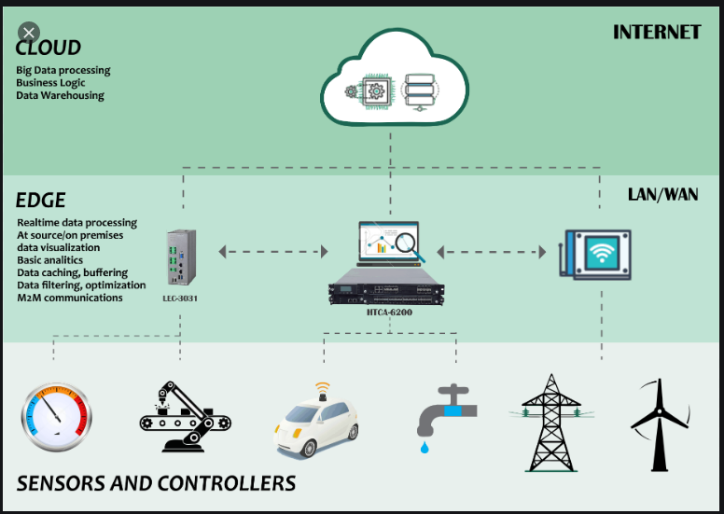
Example IoT Enabling Technologies
Book website: http://www.internet-of-things-book.com
Bahga & Madisetti, © 2015

Slide 52
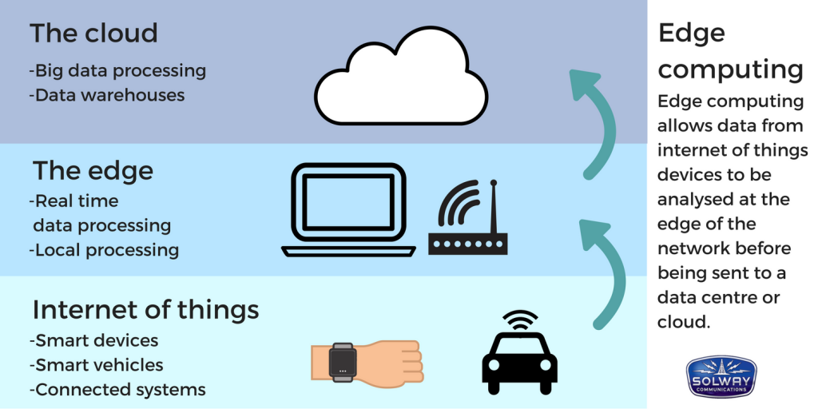
Example IoT Enabling Technologies
Book website: http://www.internet-of-things-book.com
Bahga & Madisetti, © 2015

Slide 53
IoT Levels and Deployment Templates
An IoT system comprises the following components:
Device: An IoT device allows identiﬁcation, remote sensing, actuating and remote monitoring capabilities.
Resource: Resources are software components on the IoT device for accessing, processing and storing sensor information, or for controlling actuators connected to the device. Resources also include the software components that enable network access for the device.
Controller Service: Controller service is a native service that runs on the device and interacts with the web services. Controller service sends data from the device to the web service and receives commands from the application (via web services) for controlling the device.
Book website: http://www.internet-of-things-book.com
Bahga & Madisetti, © 2015

Slide 54
IoT Levels and Deployment Templates
Database: Database can be either local or in the cloud and stores the data generated by the IoT device.
Web Service: Web services serve as a link between the IoT device, application, database and analysis components. Web service can be implemented using HTTP and REST principles (REST service) or using the WebSocket protocol (WebSocket service).
Analysis Component: This is responsible for analyzing the IoT data and generating results in a form that is easy for the user to understand.
Application: IoT applications provide an interface that the users can use to control and monitor various aspects of the IoT system. Applications also allow users to view the system status and the processed data.
Book website: http://www.internet-of-things-book.com
Bahga & Madisetti, © 2015

Slide 55
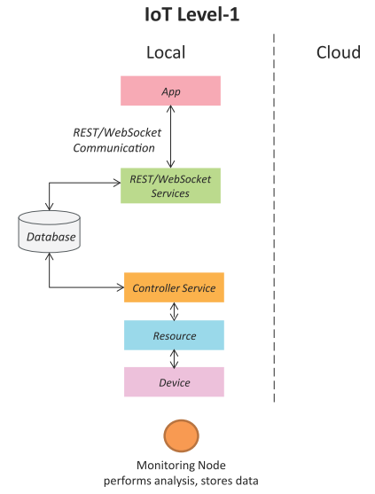
IoT Level-1
A level-1 IoT system has a single node/device that performs sensing and/or actuation, stores data, performs analysis and hosts the application.
Level-1 IoT systems are suitable for modelling low-cost and low-complexity solutions where the data involved is not big and the analysis requirements are not computationally intensive.
Book website: http://www.internet-of-things-book.com
Bahga & Madisetti, © 2015

Slide 56
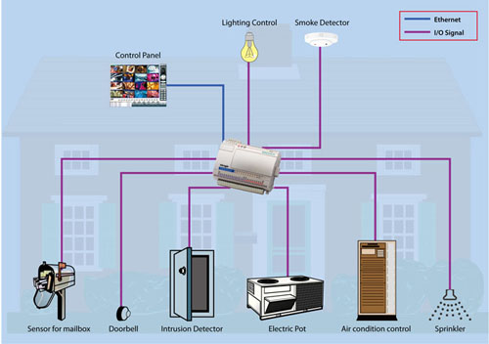
IoT – Level 1 Example …Home Automation System

Slide 57
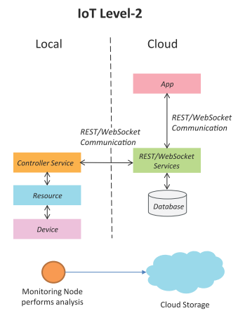
IoT Level-2
A level-2 IoT system has a single node that performs sensing and/or actuation and local analysis.
Data is stored in the cloud and the application is usually cloud-based.
Level-2 IoT systems are suitable for solutions where the data involved is big; however, the primary analysis requirement is not computationally intensive and can be done locally.
Book website: http://www.internet-of-things-book.com
Bahga & Madisetti, © 2015

Slide 58
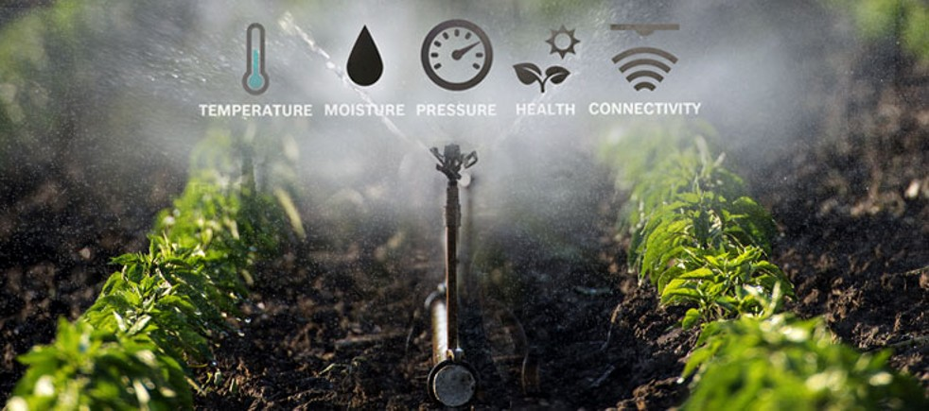
IoT – Level 2 Example …Smart Irrigation

Slide 59
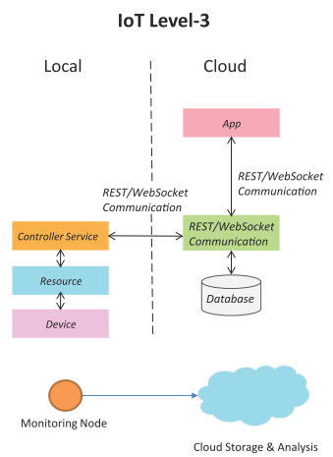
IoT Level-3
A level-3 IoT system has a single node. Data is stored and analyzed in the cloud and the application is cloud-based.
Level-3 IoT systems are suitable for solutions where the data involved is big and the analysis requirements are computationally intensive.
Book website: http://www.internet-of-things-book.com
Bahga & Madisetti, © 2015

Slide 60
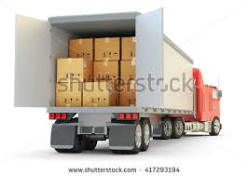
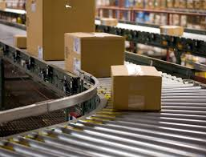
IoT – Level 3 Example …Tracking Package Handling
Sensors used accelrometer and gyroscope

Slide 61
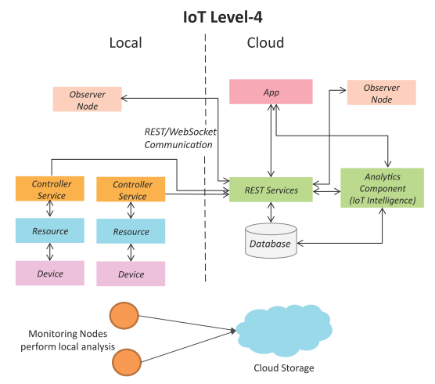
IoT Level-4
A level-4 IoT system has multiple nodes that perform local analysis. Data is stored in the cloud and the application is cloud-based.
Level-4 contains local and cloud-based observer nodes which can subscribe to and receive information collected in the cloud from IoT devices.
Level-4 IoT systems are suitable for solutions where multiple nodes are required, the data involved is big and the analysis requirements are computationally intensive.
Book website: http://www.internet-of-things-book.com
Bahga & Madisetti, © 2015

Slide 62
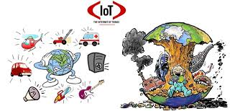
IoT – Level 3 Example …Noise Monitoring
Sound Sensors are used

Slide 63
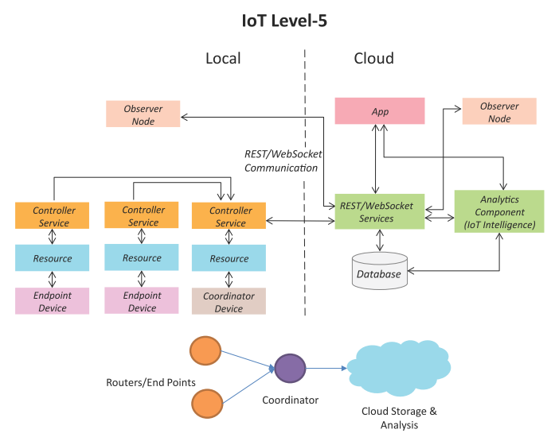
IoT Level-5
A level-5 IoT system has multiple end nodes and one coordinator node.
The end nodes perform sensing and/or actuation.
The coordinator node collects data from the end nodes and sends it to the cloud.
Data is stored and analyzed in the cloud and the application is cloud-based.
Level-5 IoT systems are suitable for solutions based on wireless sensor networks, in which the data involved is big and the analysis requirements are computationally intensive.
Book website: http://www.internet-of-things-book.com
Bahga & Madisetti, © 2015

Slide 64
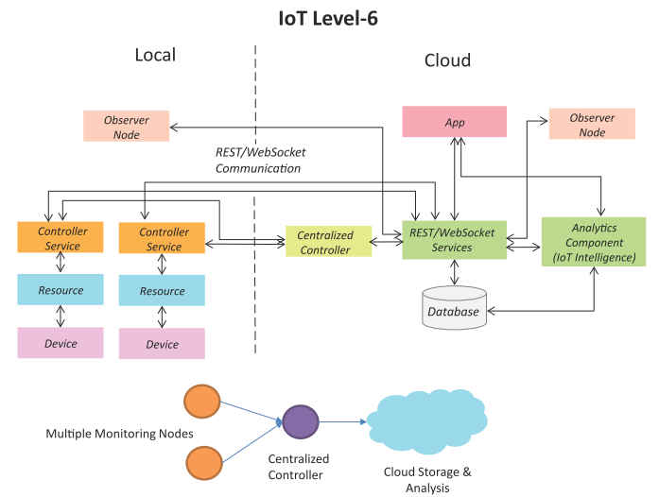
IoT Level-6
A level-6 IoT system has multiple independent end nodes that perform sensing and/or actuation and send data to the cloud.
Data is stored in the cloud and the application is cloud-based.
The analytics component analyzes the data and stores the results in the cloud database.
The results are visualized with the cloud-based application.
The centralized controller is aware of the status of all the end nodes and sends control commands to the nodes.
Book website: http://www.internet-of-things-book.com
Bahga & Madisetti, © 2015

Slide 65
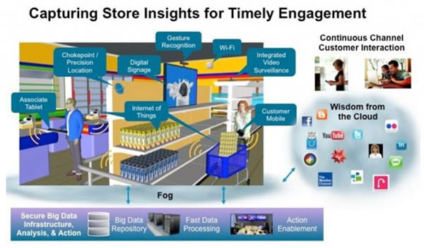
Example 1 IoT Based Store
Book website: http://www.internet-of-things-book.com
Bahga & Madisetti, © 2015

Slide 66
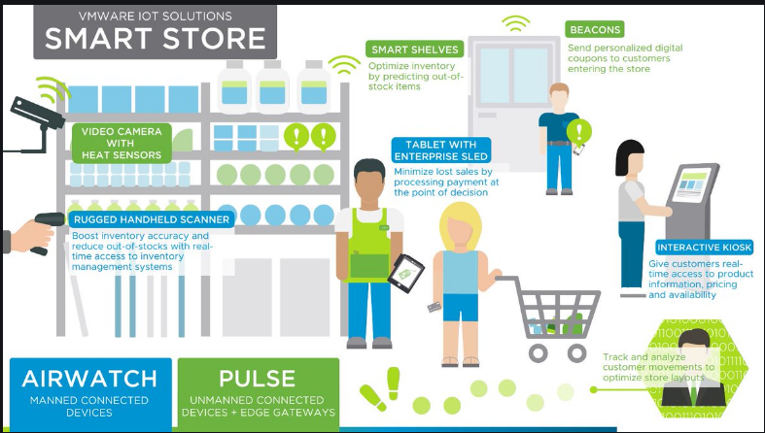
Example 2- Smart Store
Book website: http://www.internet-of-things-book.com
Bahga & Madisetti, © 2015

Slide 67
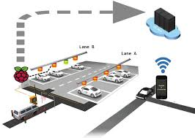
Example 3- Parking System
Book website: http://www.internet-of-things-book.com
Bahga & Madisetti, © 2015

